Slide 1
Black Death
Lori Barberian

Slide 2
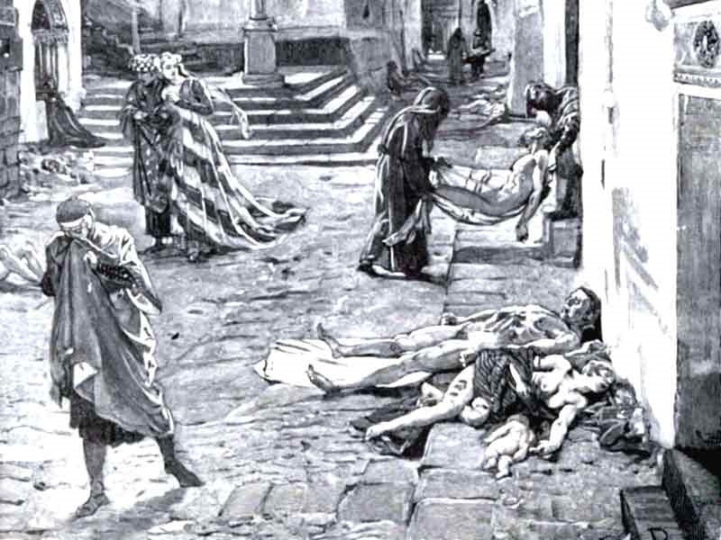
What is The Black Death?
Black Death, also known as bubonic plague, was a widespread epidemic in Europe in 1387 A.D that left one third of Europe’s population dead in the streets.

Slide 3
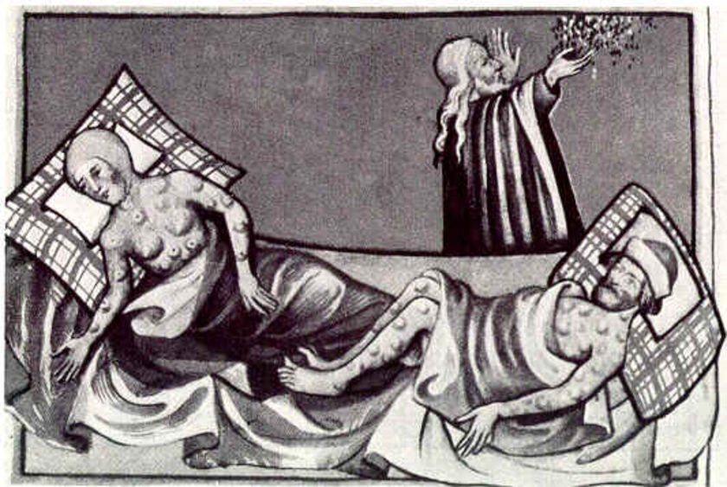
Symptoms
If anyone caught this fatal disease, symptoms would show within two to six days of getting it.
Symptoms would include fever, headache, chills, nausea, vomiting, abdominal pain, diarrhea, decreased appetite, broken blood vessels, and buboes ranging in size from 1 to 10 cm.

Slide 4
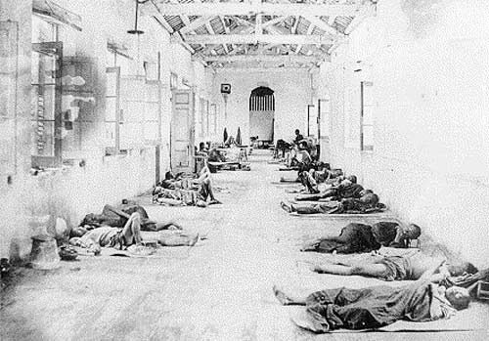
People are dying ):
This terrible disease started in the early 1330’s. The epidemic started in China, and spread to Europe, where it killed an estimated 25 million people.

Slide 5
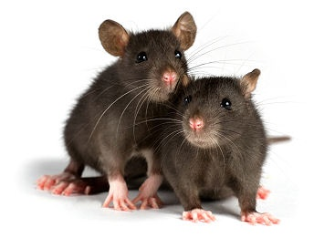
This outbreak originated in rodents. Since China was one of the busiest trading ports in the nation, their ships traveled all over. Rodents were infesting those ships, along with their disease.

Slide 6
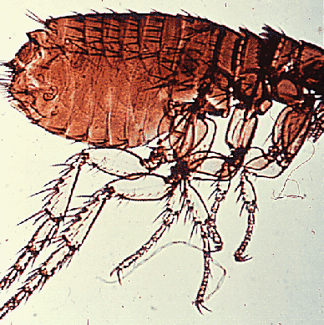
Fleas transmitted the disease from rodents to humans. Soon, it caught onto other people, and more and more people got infected. Every winter, the fleas would leave and people wouldn’t get infected as much. When spring came around, the plague claimed more lives.

Slide 7
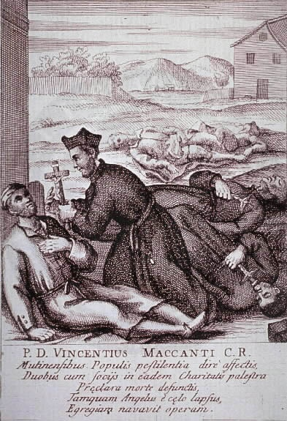
Smaller outbreaks occurred when the worst was over. This not only continued for years, but centuries. The disease did not disappear until the 1600s. Until then, survivors feared for their lives that the plague would come back.

Slide 8
Medieval society never fully recovered from this devastating time. There were many labor shortages all over Europe due to many people the disease had consumed. Because of this, workers were pretty much forced to demand higher wages, in order to support their families. Landlords refused their demands, and peasants broke out in anger. By the end of the 1300’s, in England, France, Belgium, and Italy, peasants revolted.

Slide 9
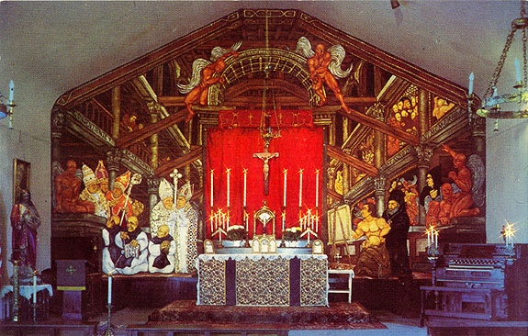
Not only did the plague affect jobs, but also took its toll on the church. When prayers of the plague disappearing went unanswered, people began to question the church and what it stood for. A new period of political and philosophical questioning was put in motion.

Slide 10
Sources;
August, The Following. "The Black Death: Bubonic Plague." Middle Ages - Medieval Resources. Web. 08 June 2010. <http://www.themiddleages.net/plague.html>.
"Bubonic Plague Symptoms." Plague Home Page. Web. 08 June 2010. <http://plague.emedtv.com/bubonic-plague/bubonic-plague-symptoms.html>.

