Slide 1
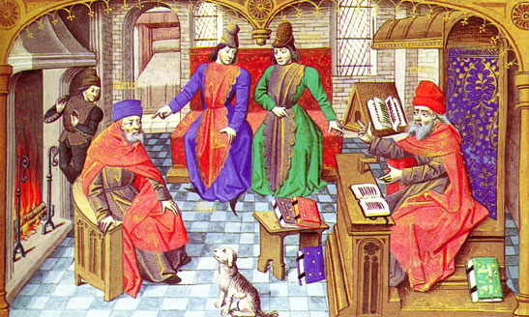
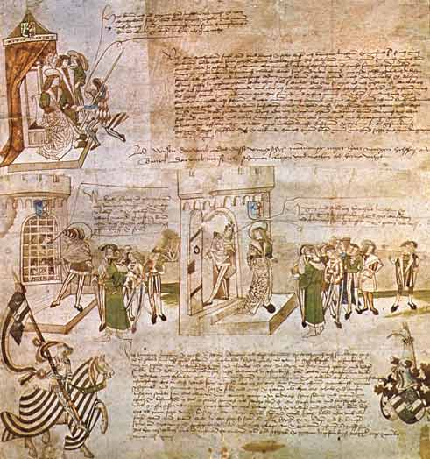
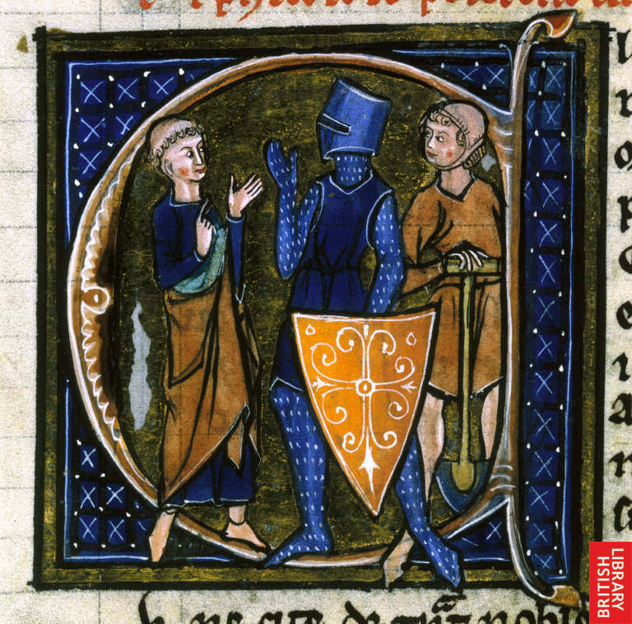
The Middle Ages

Slide 2
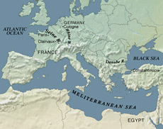
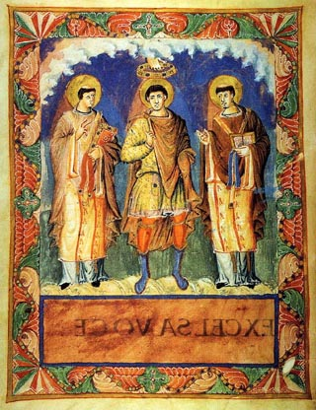
The beginning…Early Middle Ages
Decline of Roman Empire
Rise of Northern Europe
New forms of government
Heavy “Romanization” (religion, language, laws, architecture, government)
Latin- “medium aevum” means “middle age” and is source of English word “medieval”

Slide 3
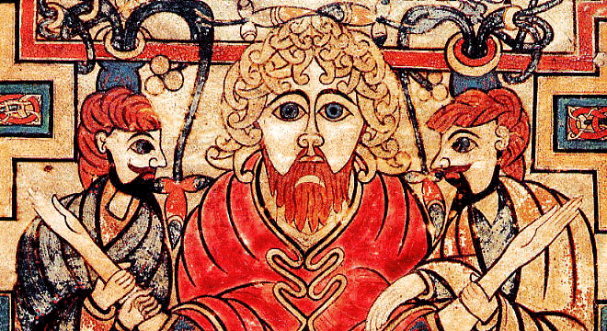
Early Middle Ages
Dark Ages (500 CE- 1000 CE)- scholars named this as a time when the forces of darkness (barbarians) overwhelmed the forces of light (Romans)
Rise of influence of barbarians as Roman Emperors had granted barbarian mercenaries land with the Roman Empire in return for military service and it was these barbarians who eventually became the new rulers

Slide 4
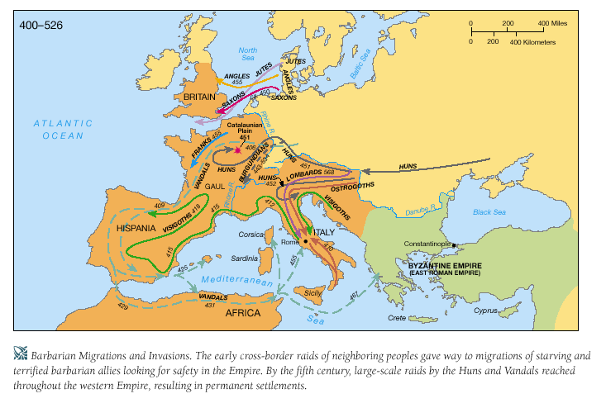

Slide 5
Warriors and Warbands in the West
Period of change in Western Europe as barbarians were migrating in to areas given up by Romans
As more barbarians moved westward, other tribes were forced to move
Groups categorized by languages and little else
Celtic: Gauls, Britons, Bretons
Germanic: Goths, Frank, Vandals, Saxons
Slavic: Wends

Slide 6
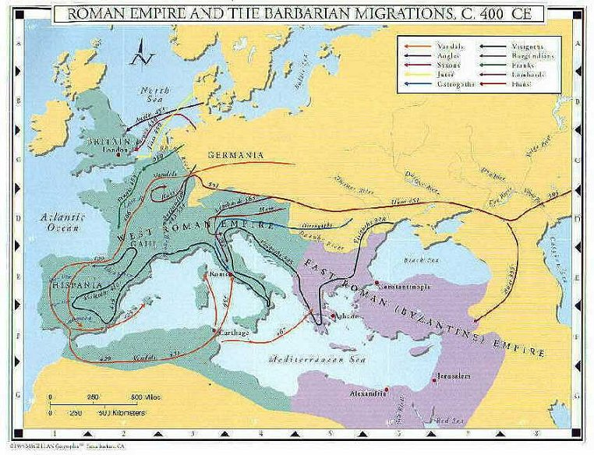

Slide 7
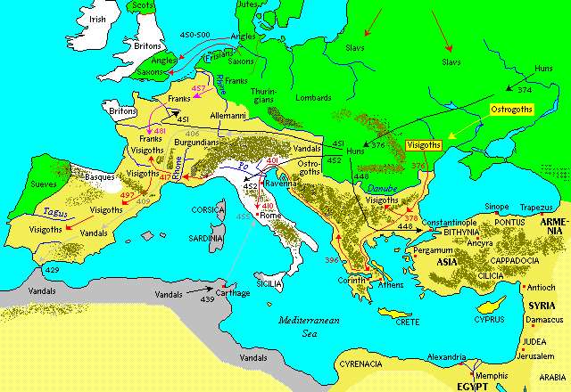

Slide 8
Expanding Influence of the Church
Christian Church has become an important political, economic, spiritual and cultural force in Europe
Leading officials of Church were the Pope and Patriarch
Banning of heresy (holding beliefs that contradict the official religion)
conversion by force
Eventually in 11th Century, Church split into two independent branches Eastern Orthodox (Greek) based in Constantinople and Roman Catholic in Rome
Notes:
Christian Church has become an important political, economic, spiritual and cultural force in Europe
Leading officials of Church were the bishops of Rome (Pope) and Constantinople (Patriarch)
As influence grew, laws were passed to forced people to become Christians and banned heresy (holding beliefs that contradict the official religion)
Fines were given against heretics, then harsher penalties and even death
Eventually, conversion by force
Eventually in 11th Century, Church split into two independent branches Eastern Orthodox (Greek) based in Constantinople and Roman Catholic in Rome

Slide 9
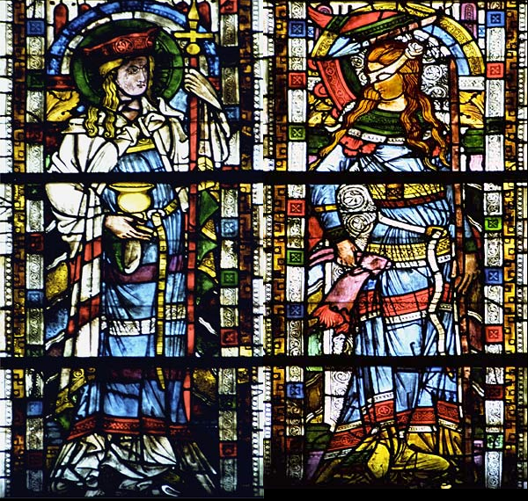
You scratch my back… I’ll scratch yours….
Church was granted favours by Roman Emperors / Kings (land, exemption from taxes, immunity in courts, positions in courts) and in return the Church would endorse kings to help secure their rule
Kings looked to Church to supply educated administrators to help run kingdoms and in return kings would enforce laws that prohibited other religions

Slide 10
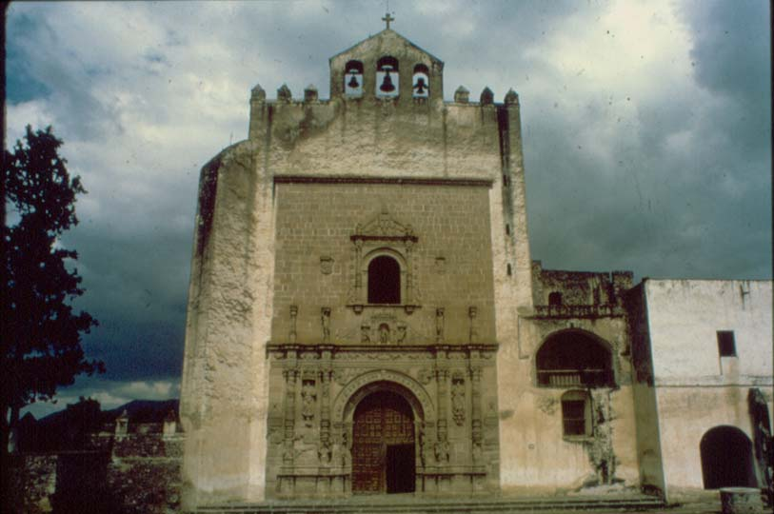
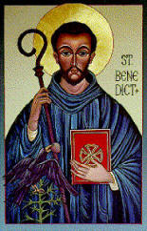
Monasticism and Saints
Monks were people who gave up worldly possessions and devote themselves to a religious life
Established between 400 -700 communities called monasteries which became centres of education, literacy and learning
Strict codes of monastic conduct called Rule of St. Benedict
Saints- one who performs miracles that are interpreted as evidence of a special relationship with God
St. Augustine- wrote “Confessions” which discussed ideas of ethics, self knowledge, and the role of free will which shaped monastic tradition and the influence of Church
Notes:
Rule of St. Benedict- years probation, solemn vows of obedience, chastity, poverty and silence, strict rules, 5-6 hours of prayer, 4 hours of spiritual reading, 5 hours of labour

Slide 11
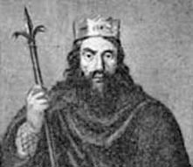
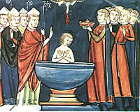
Merovingians
Merovingian is derived from the leader of the tribe of Franks
First dynasty after the Romans and ruled for 300 years
Leader in 481 CE was Clovis I- he united Frankish tribes and expanded territory
His conversion to Christianity won him support from the Church
Clovis I wrote Salic Law - assigned a specific financial value to everyone and everything; concept of trial options (trial by oath and trial by ordeal)
Merovingian's founded and built many monasteries, churches and palaces and spread Christianity throughout Western Europe
IMPACT = Eventually dynasty declined as kings relaxed power and became more like figure heads whereas the real power lay with the powerful officials and leading aristocracy
Notes:
Merovingian is derived from the leader of the tribe of Franks
First dynasty after the Romans and ruled for 300 years
Leader in 481 CE was Clovis I- he united Frankish tribes and made a large fighting force in Northern Gaul, drastically expanding his territory
His conversion to Christianity won him support from the Church
Clovis I wrote Salic Law which assigned a specific financial value to everyone and everything and in the case of a crime, the guilty had to pay the victim for losses; as well trial options (trial by oath and trial by ordeal)
Merovingian's founded and built many monasteries, churches and palaces and spread Christianity throughout Western Europe
Eventually dynasty declined as kings relaxed power and became more like figure heads whereas the real power lay with the powerful officials and leading aristocracy
He wrote Salic Law which assigned a specific financial value to everyone and everything and in the case of a crime, the guilty had to pay the victim for losses; as well trial options such as (trial by oath= people of status will swear in defence of accused) and trial by ordeal (accused to perform a physical test to show innonnce (believed that God would protect and help the innocent)

Slide 12
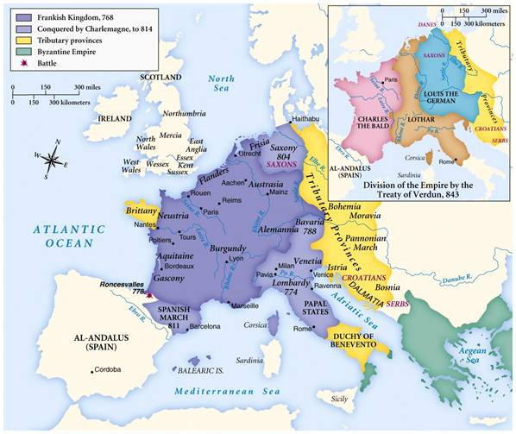

Slide 13
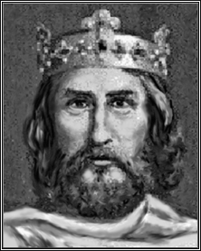
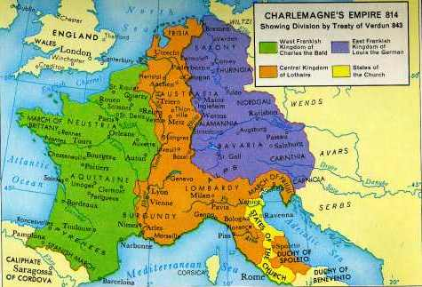
Carolingians
Rise of aristocratic Charles Martel who dominated Frankish kingdom in 8th century
He confiscated land given to Church and began Church reforms that would restore spirituality to clerical life
His son Pepin the Short continued Church reforms and eventually with the support of reformed Church, removed last Merovingian king from throne
Established the Carolingian dynasty, named to protect the papacy and establish the pope and bishops are the makers of kings
Greatest legacy was Charles the Great, or Charlemagne
Notes:
Rise of aristocratic Charles Martel who dominated Frankish kingdom in 8th century
Solidified claim with military victories in pushing Muslims south and establishing Frankish control of southern Gaul
He confiscated land given to Church and began Church reforms that would restore spirituality to clerical life
His son Pepin the Short continued Church reforms and eventually with the support of reformed Church, removed last Merovingian king from throne
Established the Carolingian dynasty, named to protect the papacy and establish the pope and bishops are the makers of kings
Greatest legacy was Charles the Great, or Charlemagne

Slide 14
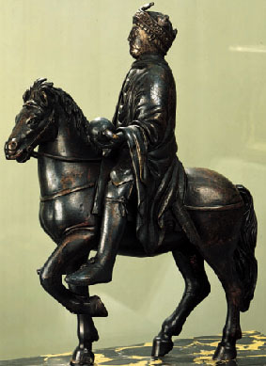
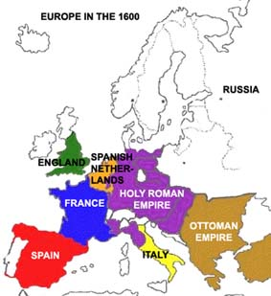
The Holy Roman Empire & Charlemagne
Charlemagne (Charles the Great) who was a military general and restored Pope Leo III who had been exiled
In return, Leo placed a crown on Charlemagne and named him the “Emperor of the Romans” which secured the relationship between Frankish kings and the papacy
Charlemagne became the first ruler of the Holy Roman Empire, a dynasty that would last for more than 700 years
Charlemagne- imposed order on empire through the Church and state
Ordered the standardization of Latin, textbooks, manuals for preaching, schools for clergy and people, new form of handwriting
All these promoted education and scholars and produced a precise written language (Latin)
Notes:
Iberbia- (present day Spain) had privileged class of estate owners called seniores; strong ties to Church; southern Spain conquered by Moors (Islamic people from North Africa) and clashes between Christians and Muslims, who were called infidels (Latin meaning unfaithful)

Slide 15
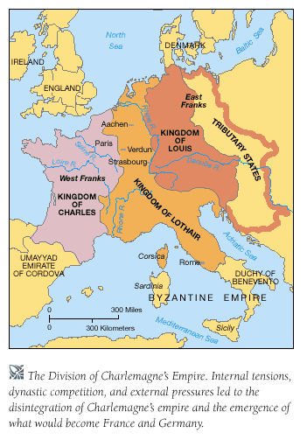
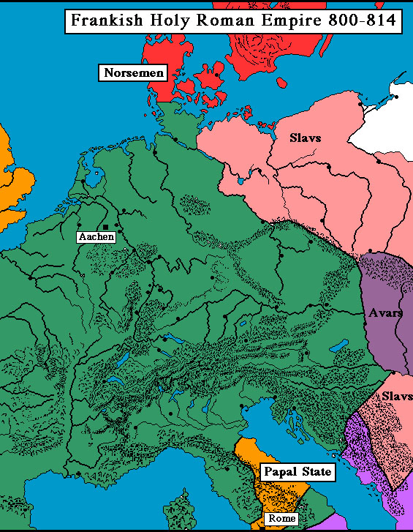

Slide 16
Slaves and Serfs
Slaves made up of conquered peoples
Some treated harshly, while other were treated fairly
Rural slaves became serfs, who worked the land and provided labour for owner (in return from protection)
Set up for system of feudalism

Slide 17
Birth of Modern Languages
Development of Middle Ages
New languages born through migration, resettlement, conflict and changes
Old English (Anglo Saxon) began to incorporate words borrowed from Latin and Old French, Old German and Old Norse
Roots of contemporary Spanish, Italian and other Romance languages

Slide 18
High Middle Ages
New royal dynasty called Capetians in France
System of primogeniture= system where eldest son inherited everything (instead of dividing land / property / wealth)
Lords and knights however had little loyalty and began competing more fiercely for land, power, influence and control
Peace of God= a set of decrees issued in 989 CE that prohibited stealing church property, assaulting clerics, peasants and women with the threat of excommunication from Church
were set to protect the unarmed populace by limiting warfare in countryside
Truce of God= set in 1027 CE and outlawed all fighting from Thursday to Monday morning, on important feast days and during religious days
Truce encouraged idea that the only combat pleasing to God was in the defence of Christendom (idea of the righteousness of holy war)
1095 CE Pope Urban II referred to Truce of God when calling knights to the first Crusade in support of Christians

Slide 19
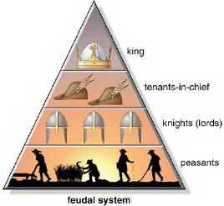
Feudalism
Increasing violence and lawless countryside
Weak turn to the strong for protection, strong want something from the weak
Feudalism= relationship between those ranked in a chain of association (kings, vassals, lords, knights, serfs)
Feudalism worked because of the notion of mutual obligation, or voluntary co-operation from serf to noble
A man’s word was the cornerstone of social life
Key terms
Fief = land given by a lord in return for a vassal’s military service and oath of loyalty
Serfs= aka villeins or common peasants who worked the lords land
Tithe = tax that serfs paid (tax or rent)
Corvee= condition of unpaid labour by serfs (maintaining roads or ditches on a manor)

Slide 20
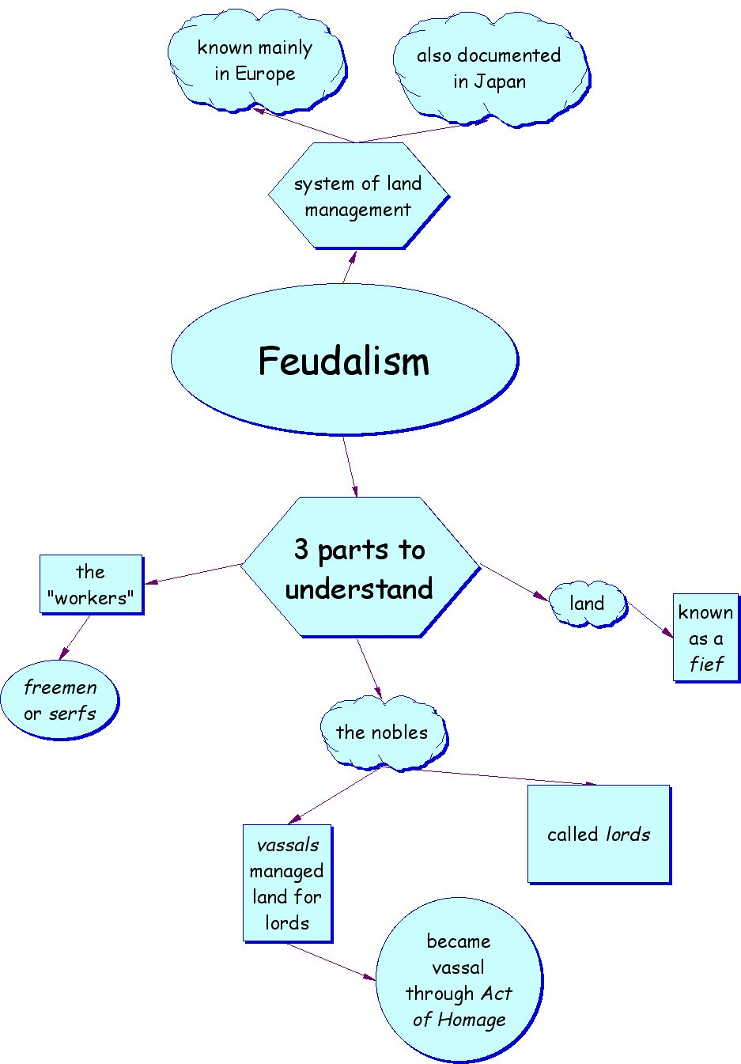

Slide 21
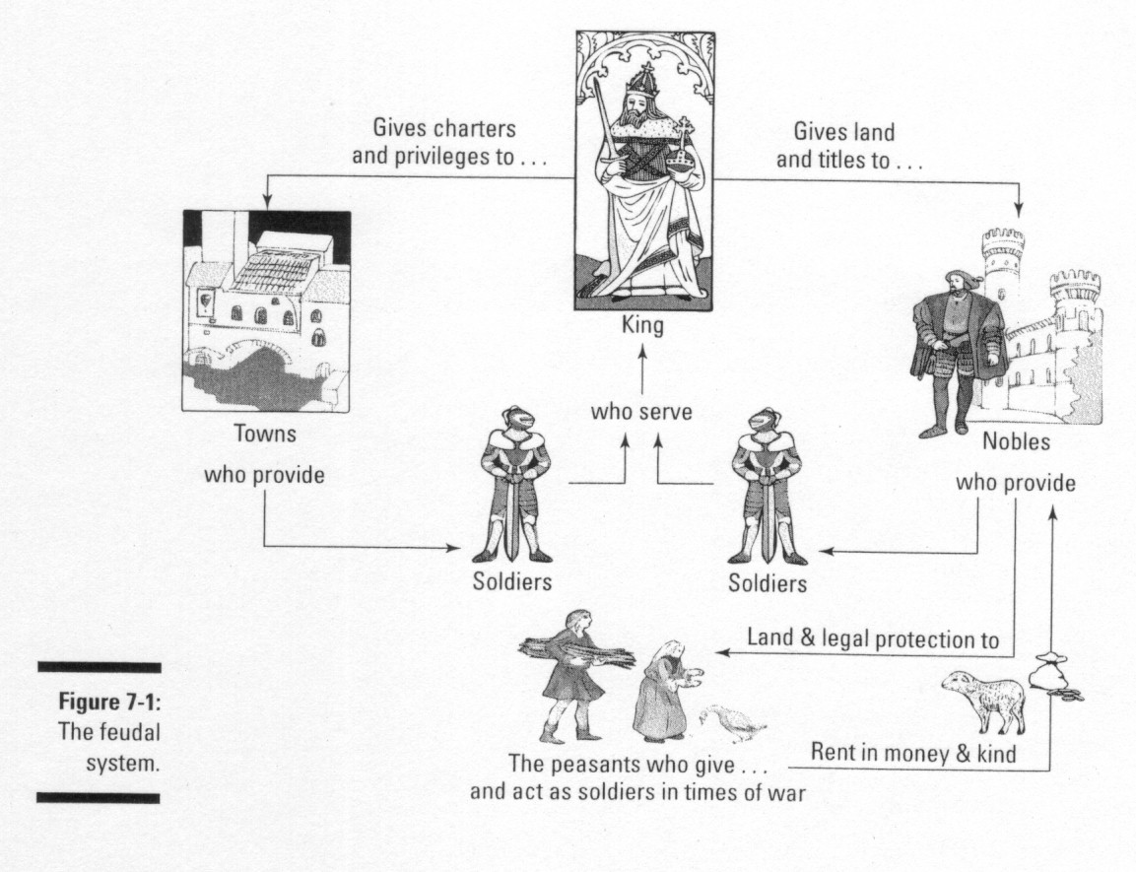

Slide 22
Wars and Conflicts
War of Investitures (Pope Gregory VII and Holy Roman Emperor Henry IV)
Norman Conquests & William the Conqueror (who was crowned King of England and ordered the Doomsday Book)
Magna Carta (king is subject to the law)
Crusades
Effects of Crusades (military failure but many positive effects (spreading of culture, goods, scientific knowledge, Arabic language and thought, economic growth in rural communities, and trade)
Notes:
(standoff between Pope Gregory VII and Holy Roman Emperor Henry IV in War of Investitures)

Slide 23
New Ideas and Culture
Effects of Crusades
Guild and communes
Towns, cities and manors
New thinkers (Thomas Aquinas) and writers
Creation of universities
New art and architecture (gothic, castles)
Knighthood and chivalry
Courtly entertainment (fables, playwrights)

Slide 24
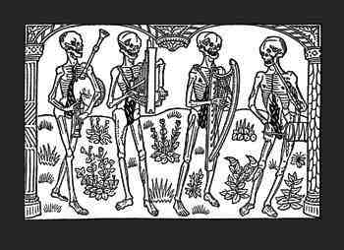
Late Middle Ages
Black Death
a devastating worldwide pandemic that first struck Europe in the mid 14th century
killed about a third of Europe’s population, an estimated 34 million people.

Slide 25
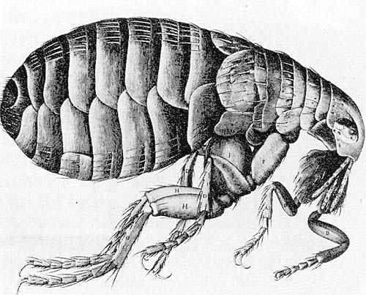
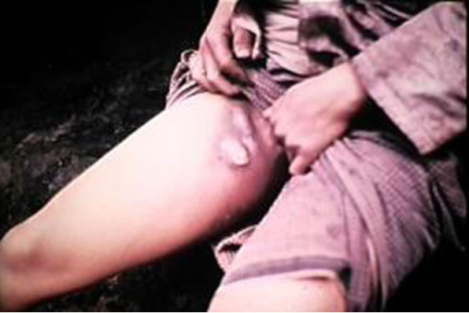
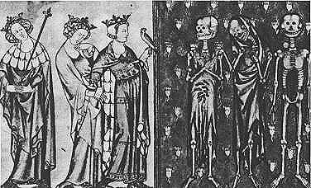
The Bubonic Plague
Called “black death” because of striking symptom of the disease, in which sufferers' skin would blacken due to hemorrhages under the skin
Spread by fleas and rats
painful lymph node swellings called buboes
buboes in the groin and armpits, which ooze pus and blood.
damage to the skin and underlying tissue until they were covered in dark blotches
Most victims died within four to seven days after infection
EFFECTS
Caused massive depopulation and change in social structure
Weakened influence of Church
Originated in Asia but was blamed on Jews and lepers

Slide 26
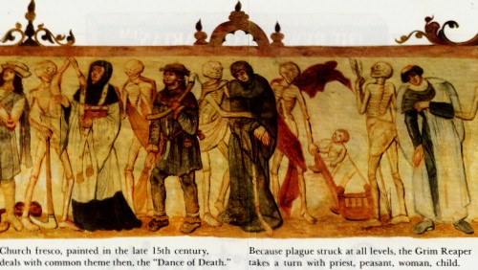

Slide 27
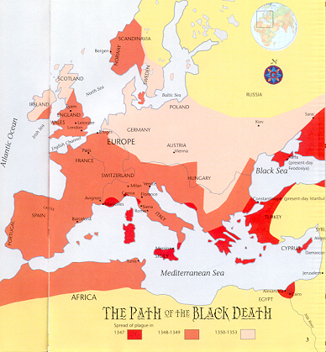

Slide 28
Illustration of the Black Death from the Toggenburg Bible (1411).

Slide 29
Ideas, Inventions and Key Figures
Roger Bacon (gunpowder)
Luca Pacioli (Father of Accounting)
Johannes Gutenberg (printing press)
Christine de Pisan (writer); Geoffrey Chaucer (writer)
Joan of Arc (Hundred Year’s War)
Pope Urban II (indulgences)
Pope Innocent IV and Bernard Gui (inquisitions)
Parliamentary Government in England

Slide 30
